Slide 1
FAIR USE NOTICE
The material used in this presentation i.e., pictures/graphs/text, etc. is solely intended for educational/teaching purpose, offered free of cost to the students for use under special circumstances of Online Education due to COVID-19 Lockdown situation and may include copyrighted material - the use of which may not have been specifically authorised by Copyright Owners. Its application constitutes Fair Use of any such copyrighted material as provided in globally accepted law of many countries. The contents of presentations are intended only for the attendees of the class being conducted by the presenter.

Slide 2
CLOUD COMPUTING
Notes:
2

Slide 3
Content
Architecture of Distributed Applications
Inter process communication
Paradigms for Distributed Applications
Issues related to distributed computing

Slide 4
ARCHITECTURE OF DISTRIBUTED APPLICATIONS
The idea of using a multi layer architecture to organize the functionalities of a data network can be applied to distributed applications. Figure below presents an example of such an architecture.
Presentation
Application (Business) Logic
Services

Slide 5
ARCHITECTURE OF DISTRIBUTED APPLICATIONS
Presentation Layer: It provides the user interface. E.g. if the application is a shopping cart, this layer generates the set of web pages that are viewable by a shopper using a browser.
Application logic layer: It provides the computation for the application. It is usually called business logic layer for enterprise applications. In our example, this layer can have tasks such as credit verification, computing amounts, sales tax and delivery cost.
Service layer: This layer provides the underlying services needed to support the functionalities of the top two layers. Services may include data access, directory services for name lookups, and inter process communication.

Slide 6
INTER PROCESS COMMUNICATION
The backbone of distributed computing is the interprocess communications (IPC): the ability for separate, independent processes to communicate among themselves to collaborate on a task.
Figure illustrates basic IPC: Here process 1 acts as sender and process 2 as receiver.
Process 1
Process 2
Data
Sender
Receiver
Notes:
Possibly on separate machines
Unicast, multicast
6

Slide 7
PARADIGMS FOR DISTRIBUTED APPLICATIONS
We will learn the paradigms in order of their level of abstraction.
High
Object space, collaborative applications
Network services , object request broker, mobile agent
Remote procedure call, remote method invocation
Client-server, peer-to-peer
Message Passing
Low
Notes:
Paradigm: a pattern or model
7

Slide 8
1. Message Passing
Basic approach; Fundamental paradigm for distributed applications
Process sends a message representing a request
Message is delivered to a receiver which processes it and sends message in response
In turn, the reply may trigger another request which leads to subsequent reply.
Basic operations: Send and Receive (Connect and Disconnect for Connection Oriented)
Processes perform input and output to each other in a manner similar to file I/O.
Socket API is based on this paradigm

Slide 9
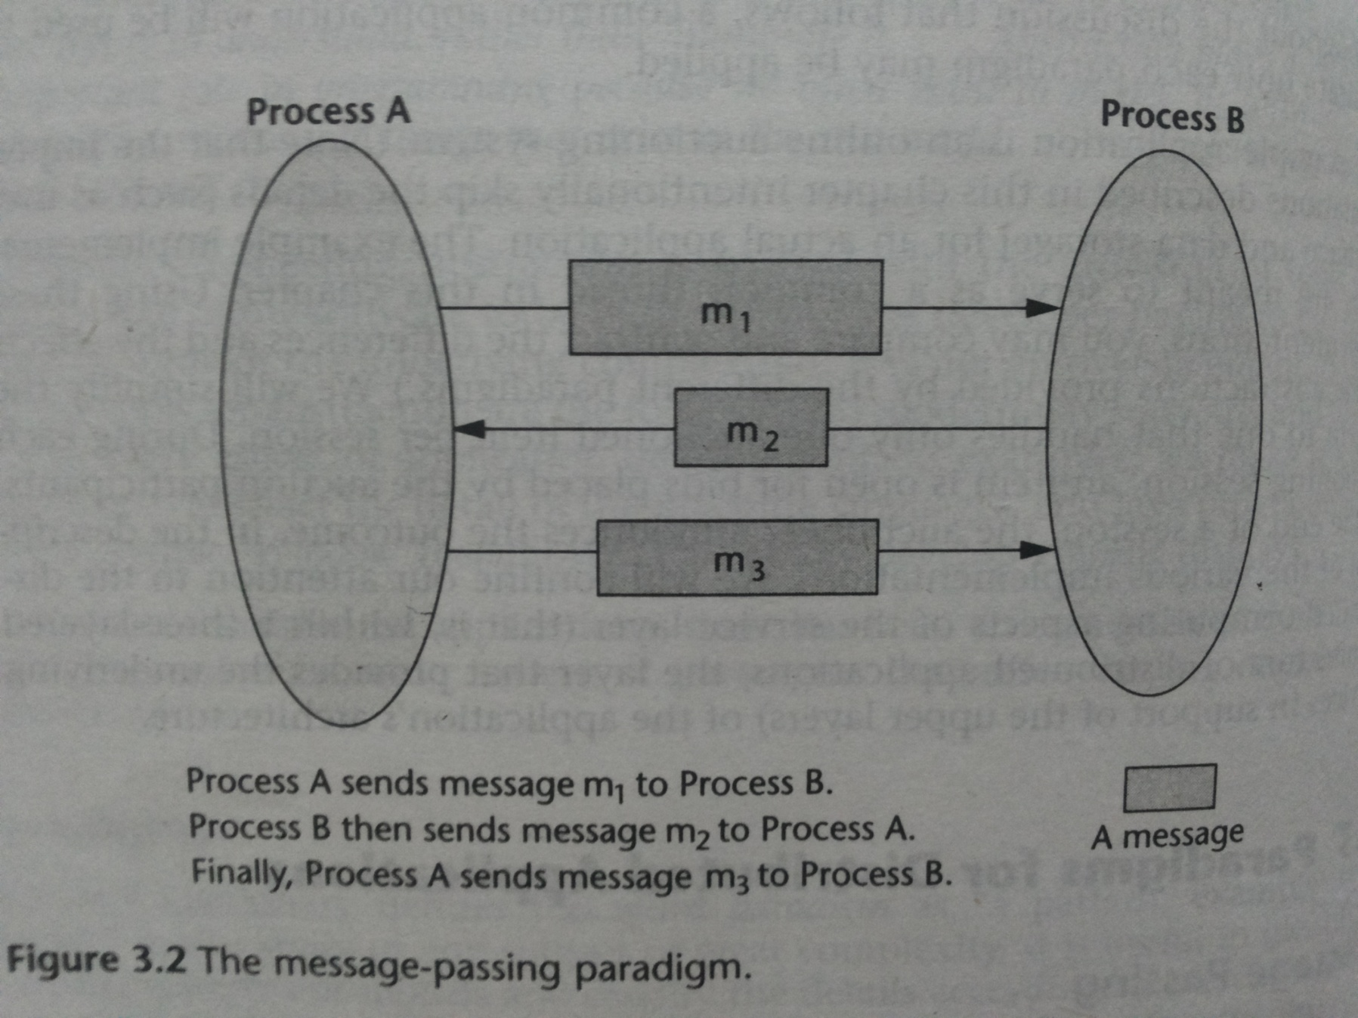

Slide 10
2. The Client-Server Paradigm
Best known paradigm for network applications
Asymmetric roles to two processes; Client And Server (Event synchronization is simplified)
Server waits passively for the requests and is thus the service provider
Client issues specific requests to the server and awaits the server’s response.
The client server model provides an efficient abstraction for the delivery of network services.
Operations: Listen and accept requests for server, issue request and accept response for the client process.
Many internet services support this paradigm. Well known are HTTP, FTP, DNS, etc.
Notes:
Auction example
10

Slide 11
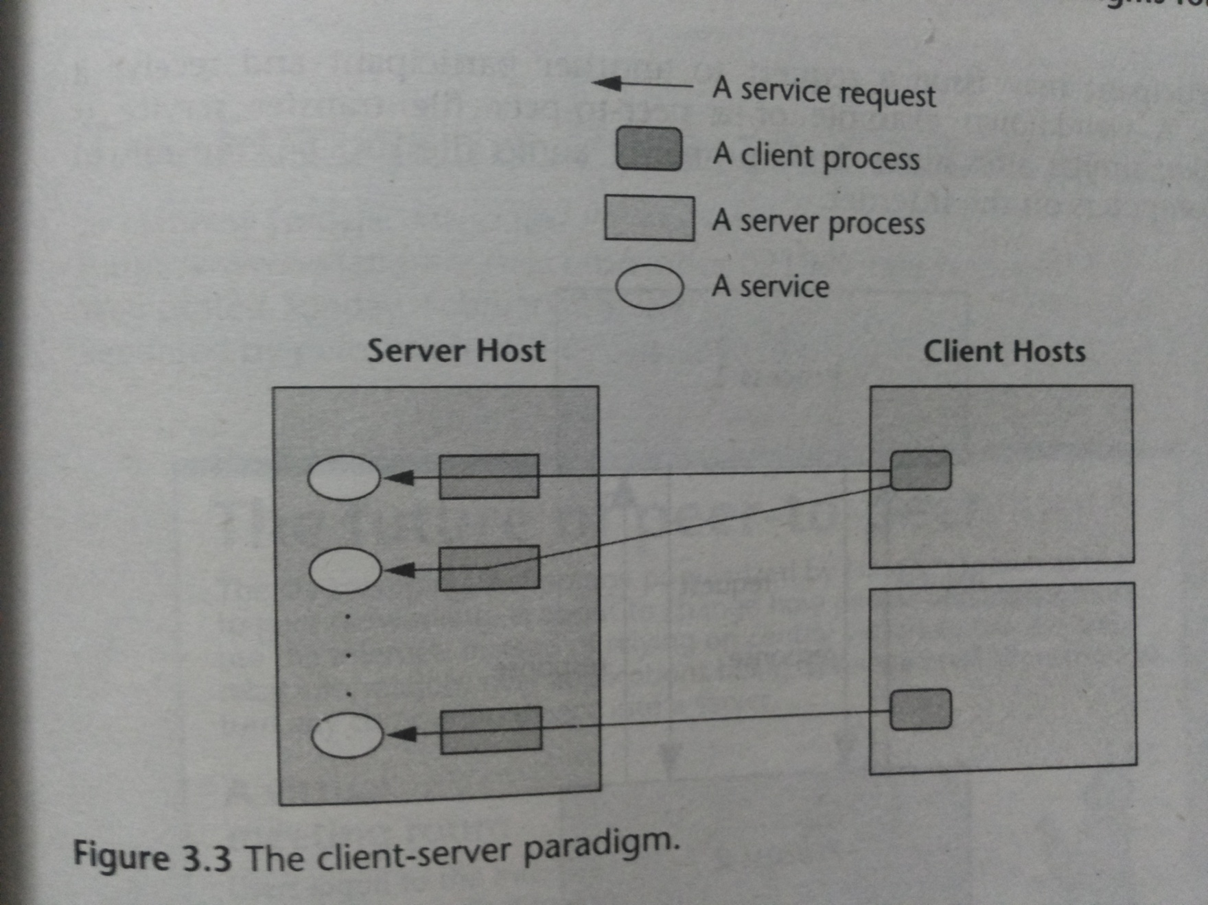

Slide 12
3. The Peer-to-Peer Paradigm
In client/server, there is no provision for server to initiate the communication.
In the peer-to-peer paradigm, the participating processes play equal roles, with equivalent capabilities and responsibilities.
Each participant may issue a request and receive a response.
It is more appropriate for applications such as instant messaging, peer-to-peer file transfers, video conferencing and collaborative work.
Possible for an application to be based on both client server model as well as peer-to-peer model.

Slide 13
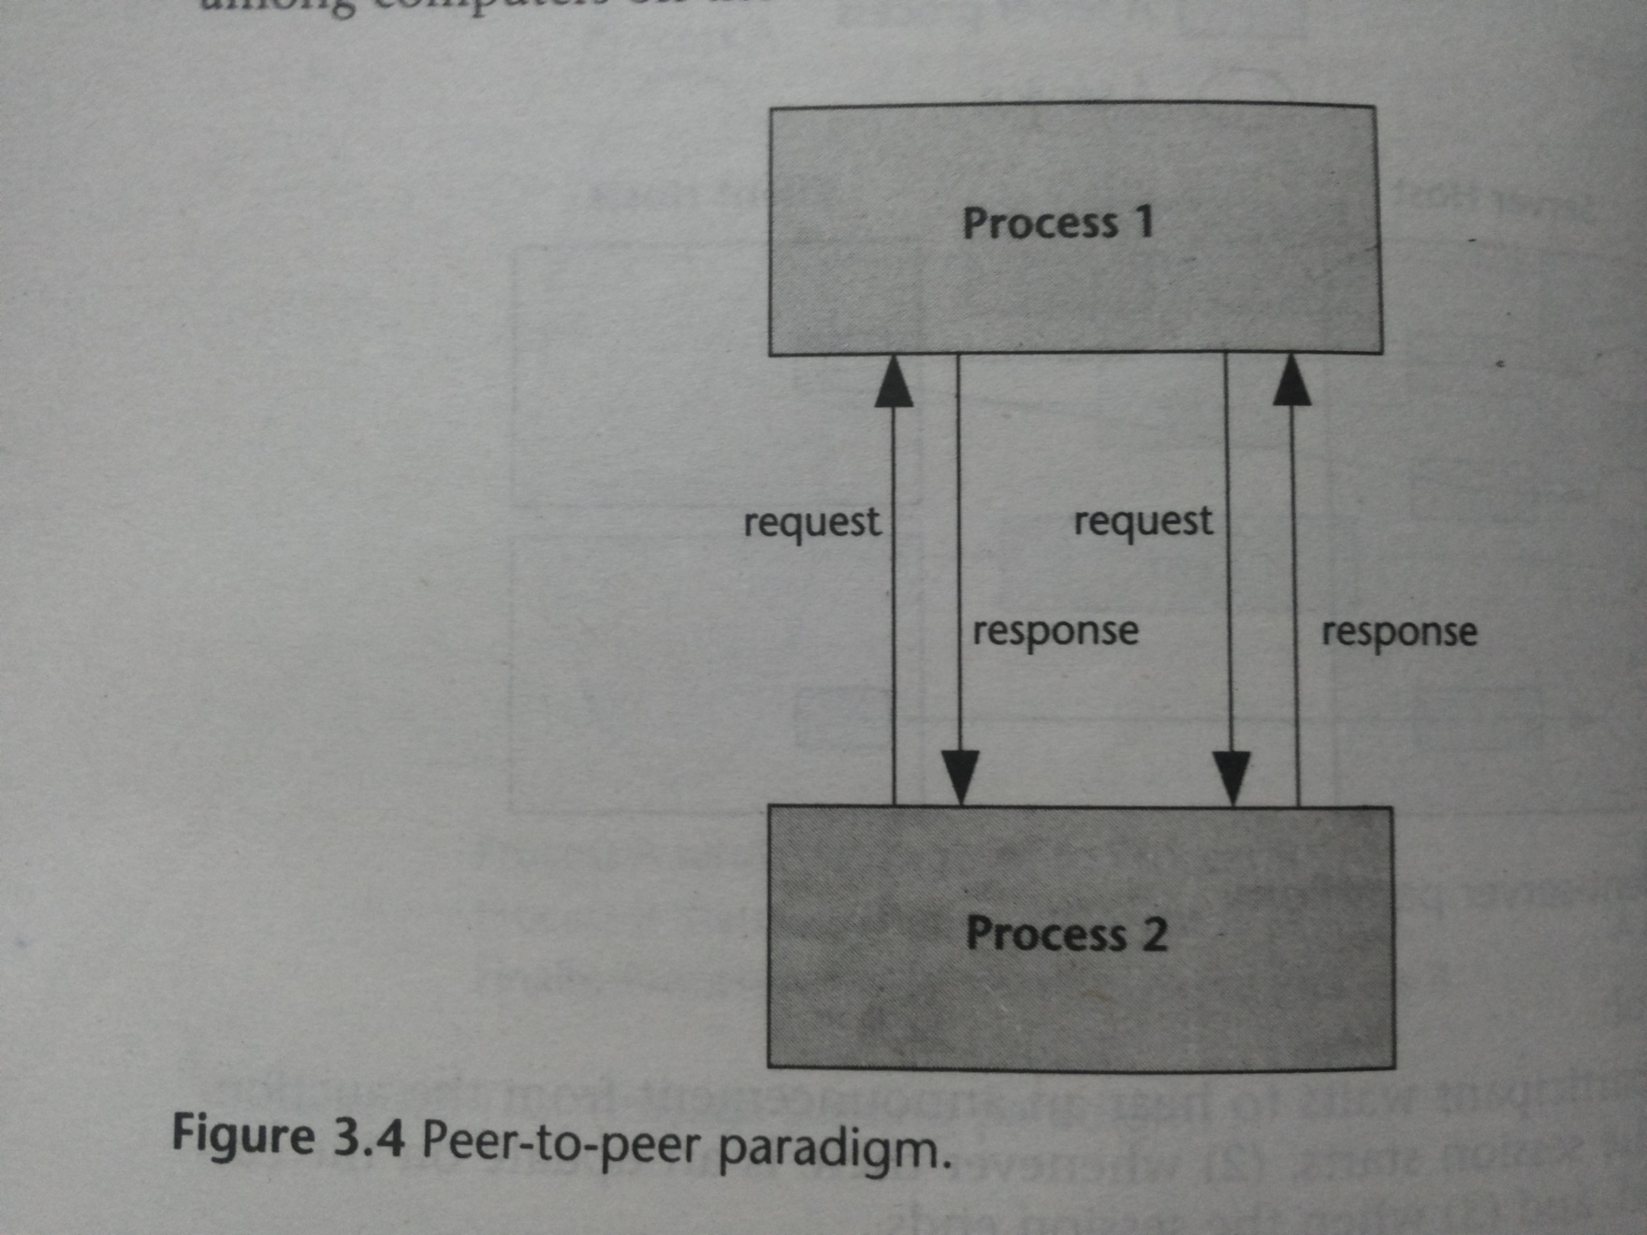

Slide 14
4. The Message System Paradigm
The Message System or Message-Oriented Middleware (MOM) paradigm is an elaboration of the basic message passing paradigm.
A message system serves as intermediary between processes. It acts as switch for processes to exchange messages asynchronously in a decoupled manner.
Sender deposits to message system which directs it to the receiver’s message queue.
There are two subtypes of message system models: the point-to-point message model and the publish/subscribe message model.

Slide 15
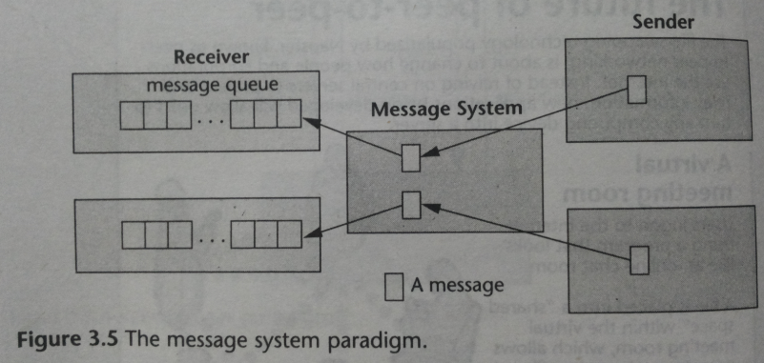

Slide 16
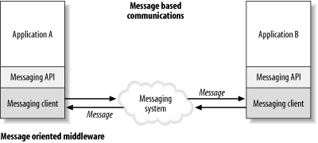
Toolkits based on the Message System Paradigm
The MOM paradigm has had a long history in distributed applications. a Message Queue Services (MQS) have been in use since the 1980’s.
The IBM MQ*Series is an example of such a facility.
Other existing support for this paradigm are:
Microsoft’s Message Queue (MSQ),
Java’s Message Service

Slide 17
The Point-to-Point Message Model
A message depository
Via the middleware, sender deposits a message in the message queue of the receiving process.
A receiving process extracts the messages from its message queue and handles each message accordingly.
This model provides additional abstraction for asynchronous operations.

Slide 18
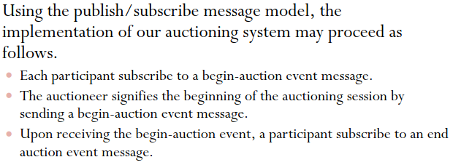
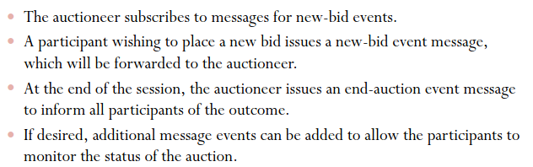
Auction System Example

Slide 19
The Publish/Subscribe Message Model
In this model, each message is associated with a specific topic or event.
Applications interested may subscribe to messages for event
When the event occurs, the process publishes a message and system distributes to subscribers.
It offers a powerful abstraction for multicasting and group communication.
The publish operation allows a process to multicast
The subscribe operation allows a process to listen for such a multicast

Slide 20
5. Remote Procedure Call Model
It was desirable to have a paradigm that allows distributed software to be written in a manner similar to conventional applications that run on a single processor.
RPC provides such an abstraction
Two independent processes which may reside on separate machines.
Process A calls a procedure that resides on Process B along with a list of arguments to the procedure
RPC triggers the predefined action in the process B, at the end of which it returns the value to process A.
MP is data-oriented, where as RPC is action-oriented.

Slide 21
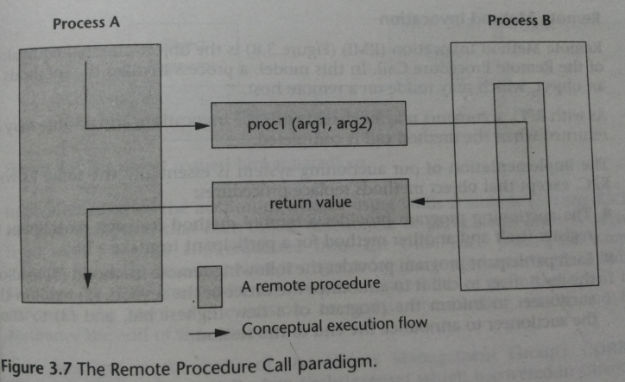

Slide 22
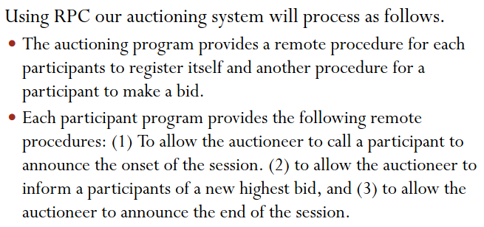
Auction System Example

Slide 23
6. The Distributed Objects Paradigms
Idea of applying object orientation to distributed applications.
Applications access objects distributed over a network.
Two paradigms are:
REMOTE METHOD INVOCATION: OO equivalent of RPC. A process invokes methods in an object that may reside on remote host.
OBJECT REQUEST BROKER: A process issues request on ORB which directs it to an appropriate object that provides the desired service. Different from RMI because it acts as mediator between heterogeneous objects allowing interactions among objects implemented using different APIs and running on different platforms

Slide 24
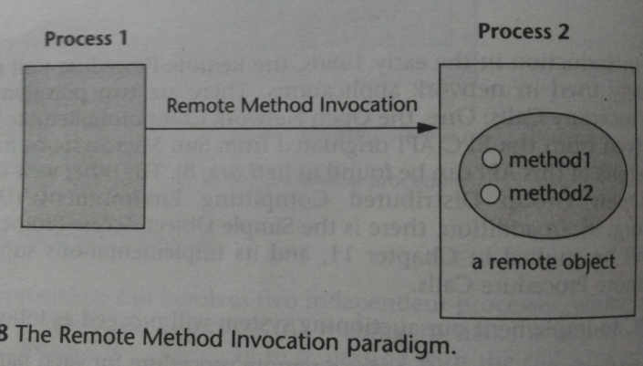
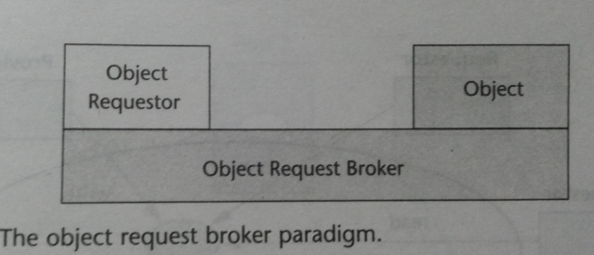

Slide 25
Auction System Example
REMOTE METHOD INVOCATION:
The implementation of our auctioning system is essentially the same as with RPC, except that object methods replace procedures
OBJECT REQUEST BROKER
Implementation of the auctioning system using ORBs is similar to using RMI, with the exception that each object (auctioneer or participant) must be registered with the ORB and requested from the ORB. Each participant issues requests to the auctioneer object to register for the session and to make bids.
Through the ORB, the auctioneer invokes the methods of each participant to announce the start of the session, to update the bidding status, and to announce the end of the session.

Slide 26
7. The Object Space
Most abstract of object-oriented paradigms.
Assumes the existence of logical entities known as object spaces.
Participants of an application converge in the common object space.
Provider places objects as entries in the object space.
And requestors that subscribe to the space may access the entries.
Virtual space/ meeting room
Hides details of looking up objects as in RMI and others.
Mutual exclusion is inherent

Slide 27
Object Space Paradigm
Requestor
Provider
read
write
Requestor
read
An Object Space

Slide 28
Auction System Example
OBJECT SPACE PARADIGM:
For the auctioning system, all participants as well as the service provider subscribe to a common object space. Each participant deposits an object into the object space to register for the session and to be notified when the auctioning session starts.
At the onset of the session, the auctioneer deposits an object into the object space. The object contains the item information and the bid history.
A participant wishing to place a bid retrieves the object from the space and, if he/she so chooses, places a new bid in the object before returning the object to the space.
At the end of the session, the auctioneer retrieves the object from the space and contacts the highest bidder.

Slide 29
8. Mobile Agent Paradigm
A mobile agent is a transportable program or object. (code, data, runtime execution, itinerary)
An agent is launched from an originating host. The agent then travels from host to host according to an itinerary that it carries.
At each stop, the agent accesses the necessary resources or services and performs the necessary tasks to accomplish its mission.
This paradigm offers the abstraction for a transportable program or object. Program is itself transported among the participants.
Numerous research projects are based on this paradigm including the D’agent and Tacoma project.

Slide 30
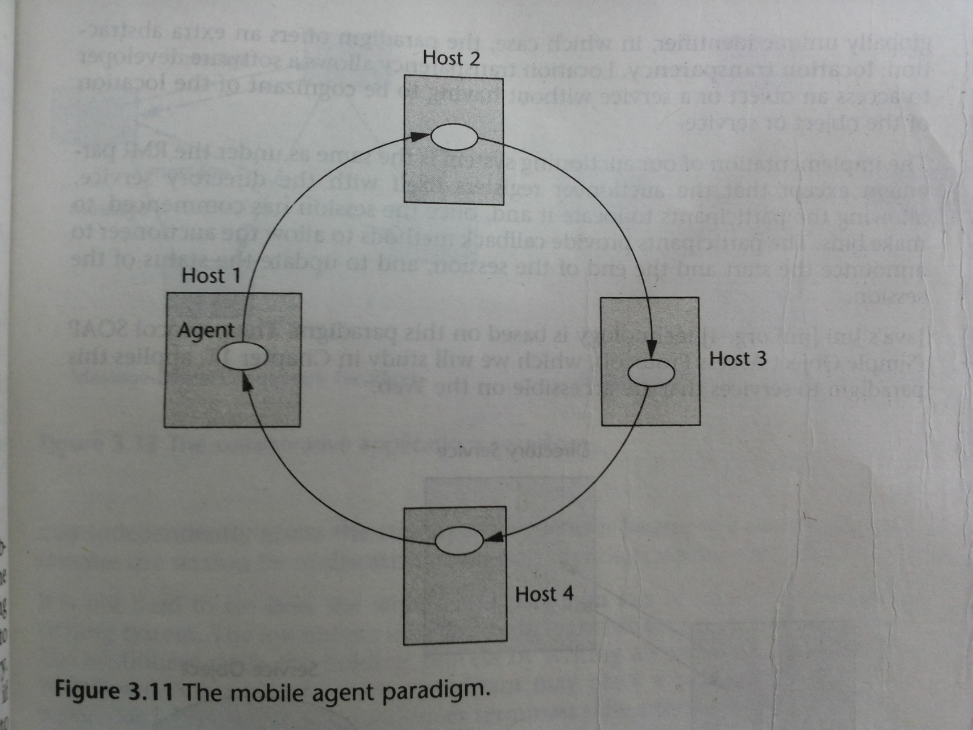

Slide 31
Auction System Example
MOBILE AGENT PARADIGM:
The mobile agent paradigm provides a novel way of implementing our auctioning system. At the onset, each participant launches a mobile agent to the auctioneer.
The mobile agent carries with it the identity, including the network address, of the participant that it represents.
Once the session starts, the auctioneer launches a mobile agent that carries with it an itinerary of the participants, as well as the current highest bid.
The mobile agent circulates among the participants and the auctioneer until the session ends, at which time the auctioneer launches the agent to make one more round among the participants to announce the outcome.

Slide 32
9. The Network Services Paradigm
In this paradigm, service providers register themselves with directory servers on a network.
A process contacts the directory server at runtime and look for desired service and if the service is available, the process will be provided a reference to the service.
This is an extension of the RMI but the difference is that service objects are registered with a global directory service, allowing them to be looked up and accessed by service requestors.
Ideally the services should be registered with a globally unique identifier, in which case, the paradigm offers location transparency.

Slide 33
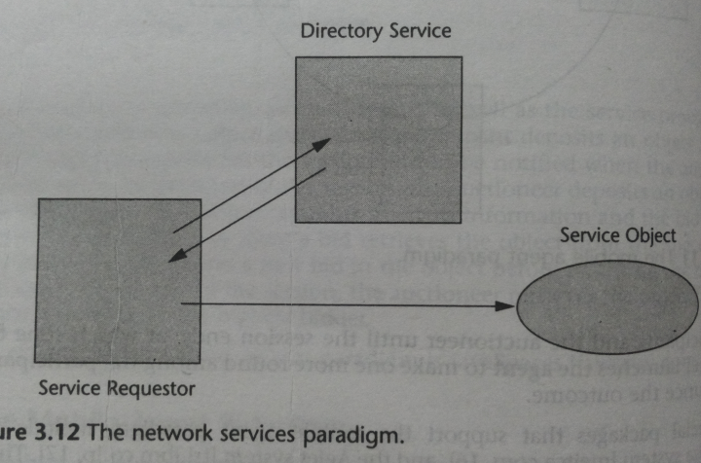

Slide 34
10. The Collaborative Application (Groupware) Paradigm
In this model for computer supported cooperative work, the processes participate in a collaborative session as a group.
Each participating process may contribute input to part or all of the group. (using multicasting)
Or they may use virtual sketchpads or whiteboards which allow each participant to read and write data to a shared display.
These two categories are shown in the following diagrams.

Slide 35
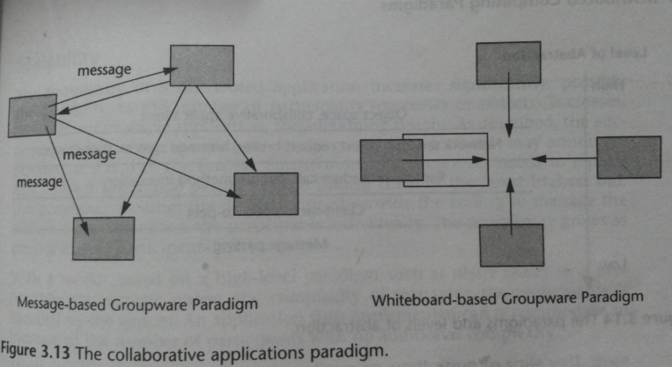

Slide 36
Auction System Example
THE COLLABORATIVE APPLICATION PARADIGM:
To implement the auctioning system using the message-based groupware paradigm, the auctioneer initiates a group, to be joined by all interested participants.
At the onset of the session, the auctioneer multicasts a message announcing the start. During the session, each bid is multicast to all participants so that each one may independently assess the status of the auction.
Finally, the auctioneer terminates the session by multicasting a message announcing the outcome.
In the second method the auctioneer and the participants share a virtual whiteboard. The auctioneer starts the bidding process by writing an announcement to the whiteboard. Subsequently, each participant may place a bid by writing to the whiteboard.
Eventually, the auctioneer terminates the session by writing a final announcement.

Slide 37
ISSUES RELATED TO DISTRIBUTED COMPUTING
Thread Synchronization (when using multithreading)
Resource Brokerage and Monitoring
Load Balancing
Distributed Transactions
Connection Pooling
Distributed Transparency
Performance/Scalability
Heterogeneity
Security
Notes:
31

Slide 38
THREAD SYNCHRONIZATION
Thread synchronization is the concurrent execution of two or more threads that share critical resources. Threads should be synchronized to avoid critical resource use conflicts. Otherwise, conflicts may arise when parallel-running threads attempt to modify a common variable at the same time.
Synchronization is used to control access to state both in small-scale multiprocessing systems -- in multithreaded environments and multiprocessor computers -- and in distributed computers consisting of thousands of units -- in banking and database systems, in web servers, and so on.
To clarify thread synchronization, consider the following example: three threads - A, B, and C - are executed concurrently and need to access a critical resource, Z. To avoid conflicts when accessing Z, threads A, B, and C must be synchronized. Thus, when A accesses Z, and B also tries to access Z, B’s access of Z must be avoided with security measures until A finishes its operation and comes out of Z.

Slide 39
RESOURCE BROKERAGE AND MONITORING
Executing a job in a grid environment requires special skills such as how to find out the actual state of the grid, how to reach the resources, etc.
As the number of the users is growing and grid services have started to become commercial, resource brokers are needed to free the users from the cumbersome work of job handling.
Though most of the existing grid middlewares give the opportunity to choose the environment for the user’s task to run, originally they are lacking such a tool that automates the discovery and selection. Brokers mean to solve this problem.
Resource brokers are data grid management computer software used in computational science research projects.

Slide 40
LOAD BALANCING
Distributing processing and communications activity is done evenly across a computer network so that no single device is overwhelmed.
Load balancing is especially important for networks where it's difficult to predict the number of requests that will be issued to a server.
Busy websites typically employ two or more Web servers in a load balancing scheme. If one server starts to get swamped, requests are forwarded to another server with more capacity. Load balancing can also refer to the communications channels themselves.
Load balancing is the most straightforward method of scaling out an application server infrastructure. As application demand increases, new servers can be easily added to the resource pool, and the load balancer will immediately begin sending traffic to the new server.

Slide 41
DISTRIBUTED TRANSACTIONS
A distributed transaction is a transaction that updates data on two or more networked computer systems.
Distributed transactions extend the benefits of transactions to applications that must update distributed data.
In general, transactions involve the following steps:
Applications call the transaction manager to begin a transaction.
When the application has prepared its changes, it asks the transaction manager to commit the transaction. The transaction manager keeps a sequential transaction log so that its commit or abort decisions will be durable.

Slide 42
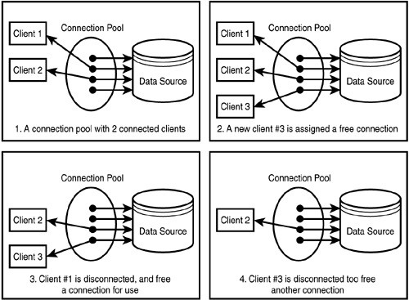
CONNECTION POOLING
A cache of database connections maintained in the database's memory so that the connections can be reused when the database receives future requests for data.
Typically, opening a database connection is an expensive operation, especially if the database is remote.
Connection pools are used to enhance the performance of executing commands on a database.
Connection pooling also cuts down on the amount of time a user must wait to establish a connection to the database.

Slide 43
DISTRIBUTED TRANSPARENCY
Access transparency
Memory access: DSM
Function call: RPC and RMI
Location transparency
File naming: NFS
Domain naming: DNS
Migration transparency
Automatic state capturing and migration
Concurrency transparency
Event ordering: Message delivery and memory consistency
Other transparency:
Failure, Replication, etc.
Notes:
Network File System (NFS) is a distributed file system protocol originally developed by Sun Microsystems in 1984,^{[1]} allowing a user on a client computer to access files over a network much like local storage is accessed
37

Slide 44
PERFORMANCE/SCALABILITY
Unlike parallel systems, distributed systems involve OS intervention and slow network medium for data transfer
Send messages in a batch:
Avoid OS intervention for every message transfer.
Cache data
Avoid repeating the same data transfer
Avoid centralized entities and algorithms
Avoid network saturation.

Slide 45
HETEROGENEITY
The internet has enabled users to access services and run applications over heterogeneous collection of computers and networks.
Data and instruction formats depend on each machine architecture
If a system consists of K different machine types, we need K–1 translation software.
If we have an architecture-independent standard data/instruction formats, each different machine prepares only such a standard translation software.

Slide 46
SECURITY
Lack of a single point of control
Security concerns:
Messages may be stolen by an enemy.
Messages may be plagiarized by an enemy.
Messages may be changed by an enemy.
Services may be denied by an enemy.
Cryptography is the only known practical mechanism.

